Slide 1
Family & Morale, Welfare & Recreation
Family and MWR - Marketing
4JUNE 2020

Slide 2
Getting the Word Out – Social Media
Stay Connected with MWR!
@FamilyandMWR
@StuttgartfamilyMWR
@StuttgartMWR
Stuttgart Family and MWR
102.3 AFN The Eagle (Radio)
AFN Blue Pages (TV)
Join our weekly emailer by visiting our website or Facebook page and subscribing to Stuttgart Happenings!
#MWRPodSquad
Stuttgart.armymwr.com

Slide 3
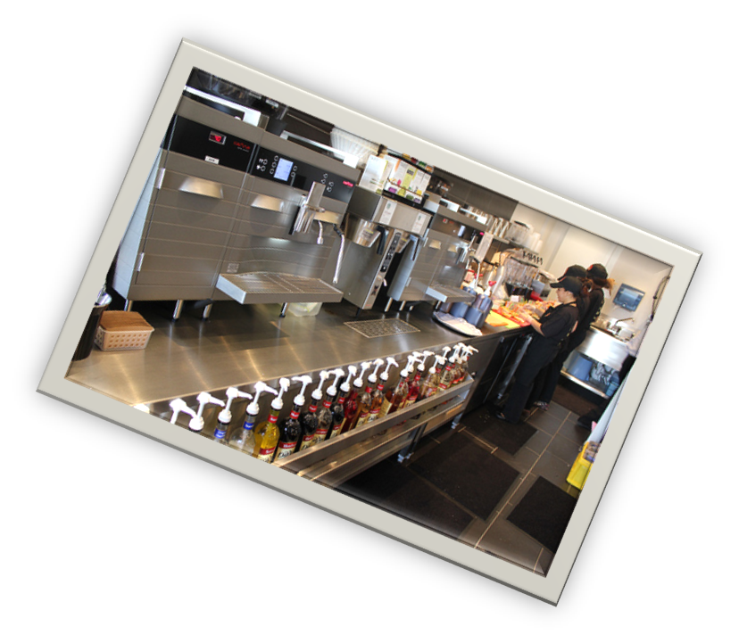
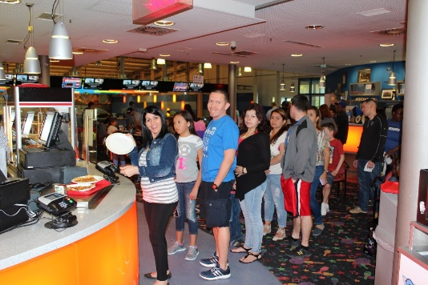
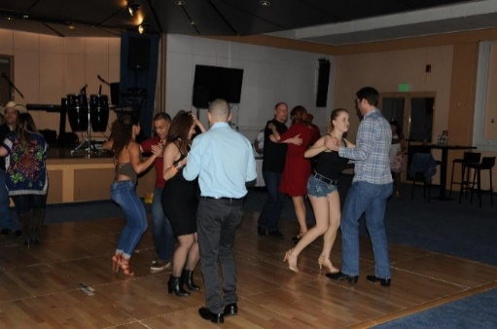
Business Operations Division
Stuttgart Golf Course (18-hole)
Golfer’s Garden Restaurant
Pro Shop
Driving Range
Storage units
Galaxy Bowling & Entertainment Center
Strike Zone Grill
Irish Pub
Warrior Zone & BOSS
Slot Machines
Free WiFi
Java & Broadway Café
Starbucks Coffee
Free WiFi
Pastries, sandwiches & snacks
Community Clubs
Swabian Special Events Center
Patch Community Club & Backlot Bar
Kelley Club
Clubs offer conference & catering
Slot Rooms @ Kelley/Patch, open 24/7
Free WiFi

Slide 4
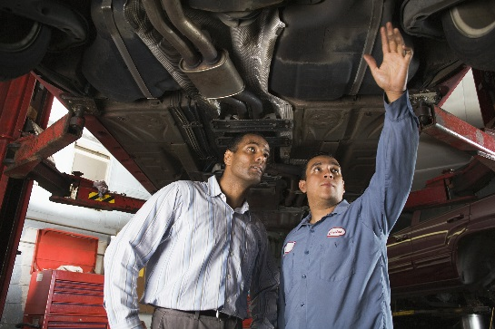
Community Recreation Division
Patch Arts & Crafts
Retail
Instructional classes
Laser engraving
Framing
Photo printing
Balloons
Host a birthday or special event
Kelley Arts & Crafts Woodshop
Woodworking tools
Instructional classes
Pottery wheel
Auto Skills Center
Speedy Lube – oil and tire changes
Patch drive-thru car wash
Kelley self-service car wash
Towing service
Vehicle resale lot (lemon lot)
Vehicle donations
Used car bid lot

Slide 5
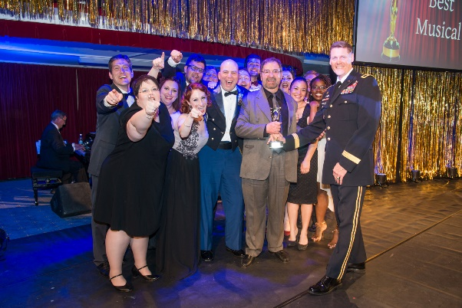
Community Recreation Division
Stuttgart Theatre Center
Award winning theatre
Seasonal plays
Volunteers wanted
Outdoor Recreation
Equipment rentals – camping, ski/snowboard, bike, games
Daily, weekend and seasonal options
Event rentals – bouncy castles, grills, canopies and outdoor heaters
Hunting and Fishing
Paintball
Warrior Adventure Quest – Active Duty Army only
Indoor Rock Climbing
Patch Library
Largest Collection in Europe
Intra-library Loan Service
Access to More than 50 Online Research Databases
Programs for Kids, Teens, & Adults
Free Wi-Fi

Slide 6
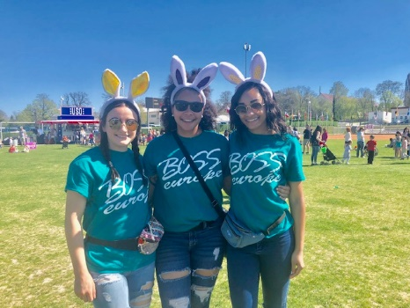
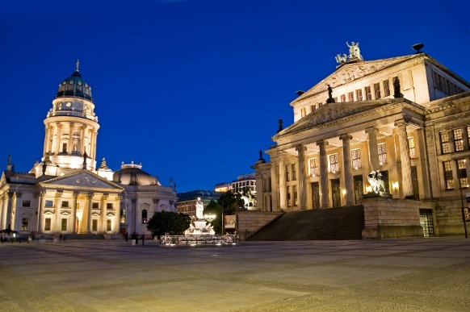
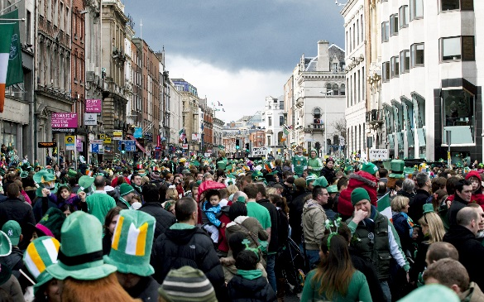
Community Recreation Division
Better Opportunities for Single Service Members (BOSS)
Improve service member quality of life
Give back to the community
Meetings every 3rd Thu. 11:45 a.m. – 1p.m.
BOSS Bowling 3rd Thu. 6 – 10 p.m.
Warrior Zone
BOSS Weekly meeting space
Open to all service members
MWR Tours
Group Travel
Day Trips
Weekend Trips
Adventure Trips
Personalized Group Travel

Slide 7
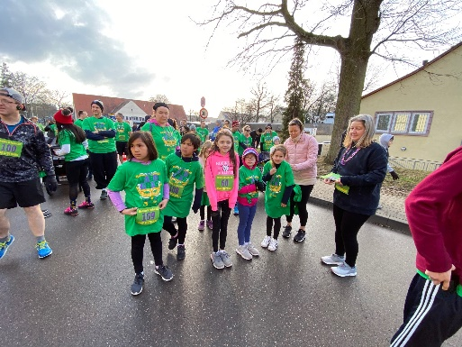
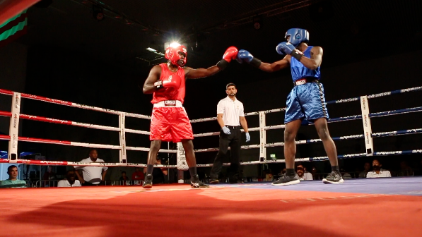
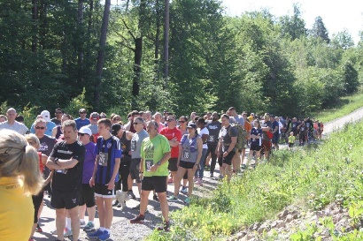
Community Recreation Division
Fitness Center Facility Services
4 Fitness Centers – Kelley, Patch, Panzer and RB
Cardiovascular Areas
Free Weights, Circuit Machines, Gear Check-out
Gym, Racquetball Courts, Tennis Courts
Group Fitness Classes
Patch Barracks & Kelley Barracks Running Track
Family Fitness Rooms
Saunas
Massage Therapy
Fitness Instructors & Personal Trainers always wanted!
Unmanned Access at Kelley, Panzer & Patch Fitness Center
Wi-Fi at Kelley, Panzer and Patch Fitness Center

Slide 8
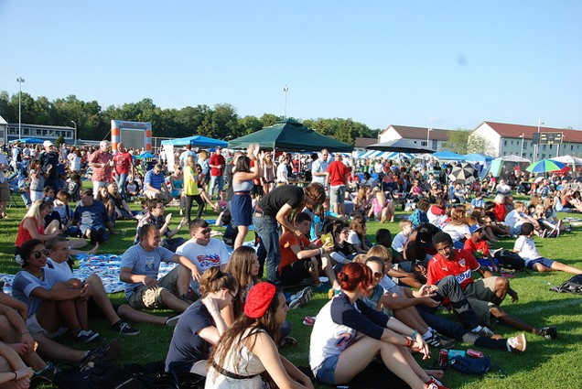
Community Recreation Division
Sports and Special Events
Races and Runs (5K, 10K, half marathon)
Fitness Incentive Programs
Dodgeball, Basketball, and Softball Tournaments
Community Events
- 4th of July Celebration
- Spring Bazaar
- CARE Fair
- Frosty Fest and More

Slide 9
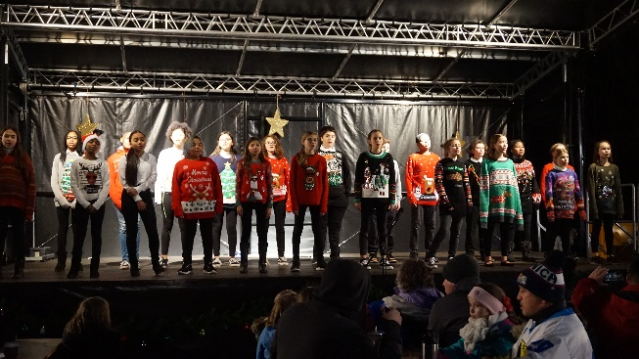
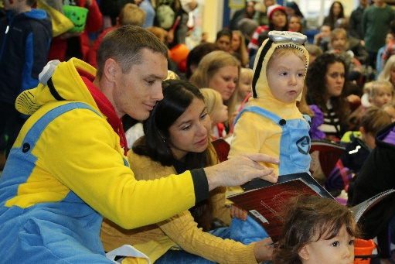
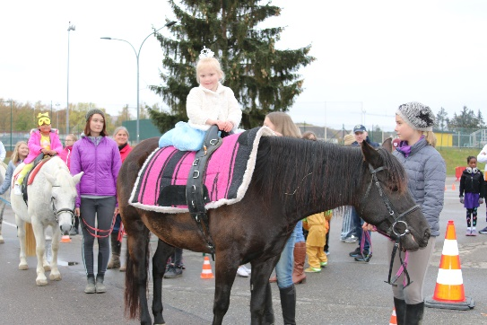
Child and Youth Services
Child and Youth Services
Parent Central & Outreach Services
Youth Centers
WiFi
Youth Sports (Winter/Spring/Summer/Fall)
Volunteer Coaching
SKIES Unlimited Instructional Programs
Child Development Centers (CDCs)
School Liaison Officers (SLOs)
Special Events
Young American, Harvest Fest and Spring Fest
Parent’s Day Out / Parent’s Night Out

Slide 10
Army Community Services
Programs available from ACS
Information and Referral
Unofficial Translation Services
Host Nation Orientation
Lending Closet
Army Volunteer Corps
Employment Readiness Program
Financial Readiness Program
Mobilization and Deployment
Survivor Outreach Services
Exceptional Family Member Program (EFMP)
New Parent Support Program
Family Advocacy Program
Child Abuse & Neglect – Military Police, DSN: 596-3102 CIV: 09641-70-596-3102
Domestic Violence - Domestic Violence Hotline: 24/7 CIV: 01725-77-4927
Sexual Harassment Assault Response Prevention Program (SHARP)

Slide 11
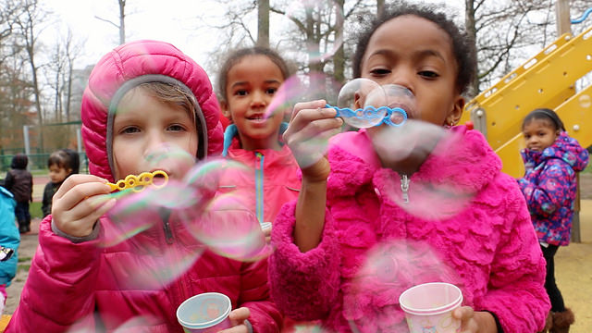
Family and MWR
All information on Family and MWR events and programs
is available 24/7 at
STUTTGART.ARMYMWR.COM

