Slide 1
In-Processing Brief
Jeremy Plumley
ACS Coordinator
USAG Stuttgart
01 June 2020

Slide 2
Relocation Readiness
Information and Referral
Unofficial Translation Services
bills/correspondence, etc.
Host Nation Orientation
Lending Closet
Includes pots, pans, dinnerware, small appliances, strollers, highchairs, utensils, car seats, etc.
Available to incoming and outgoing personnel, to include; Active Duty, DOD civilians and contractors
Items may be borrowed for up to 60 days
Notes:
Relocation Readiness can assist all personnel currently transitioning from one installation to another. For more information, please call the ACS front desk phone number.

Slide 3
Additional ACS Services
Army Volunteer Corps
Register as a volunteer and find opportunities in the community at www.myarmyonesource.com
OPM recognizes volunteer hours as actual paid experience on resumes
Employment Readiness Program
Resume review and coaching
Navigating USAJOBS
Employment information
Virtual Job fairs and targeted hiring events

Slide 4
Additional ACS Services
Financial Readiness Program
Basic Investment and Financial Planning classes
Debt Management
Army Emergency Relief (AER)
Assistance for all branches available
Financial In/Out processing available for all first term soldiers
Financial classes, to include: thrift savings plan, estate planning, savings, scholarship, student loans, etc.

Slide 5
Additional ACS Services
Mobilization and Deployment
Soldier Family Readiness Group (SFRG) and CARE Team Pre-Deployment Preparation
Personnel Readiness Processing
Survivor Outreach Services
Provides outreach and support regardless of the deceased Service Member’s Army component, duty status, location or manner of death
Survivors include spouses, children, parents, siblings, grandparents and other family members

Slide 6
Exceptional Family Member Program (EFMP)
Medical
Enrollment is mandatory for Active Duty and their families requiring specialized medical or educational care
Reevaluation every 3 years or as needed
Medical Case Coordinator located at the Patch Health Clinic
Family Support
Support services available for all Service Members, DOD Civilians, Contractors and their families
Families MUST In-Process with the ACS EFMP Family Support within 10 Calendar Days of arrival
Resources and Referrals to local agencies
Support Groups and Monthly Events

Slide 7
Family Advocacy Program
New Parent Support Program
Pregnancies, newborns, & children up to 4 years old
Home and hospital visits
Prenatal classes, education on developmental stages
Support groups
Basic infant care information
Lactation consultation
Available to all I.D. card holders
Information and referral

Slide 8
Family Advocacy Program
Child abuse and neglect
Definition: the physical or mental injury, sexual abuse or exploitation, or negligent treatment of an unmarried person under the age of 18 by a parent or legal guardian, foster parent, or caregiver.
Child supervision policy can be found under the “youth tab” on the www.stuttgartcitizen.com website
In 2000, Germany passed a law illegalizing corporal punishment
Reporting Point of Contact
Military Police
DSN: 596-3102
CIV: 09641-70-596-3102

Slide 9
Family Advocacy Program
Domestic Violence Victim Advocate (DAVA) Services Provided:
Provides shelter for abuse victims
Develops safety plans
Assists in obtaining no contact orders
Coordinates counseling services
Assists with legal and medical issues
Provides information and referrals
Assists with transitional compensation (financial)
Domestic Violence Hotline: 24/7
CIV: 01725-77-4927

Slide 10
USAG Stuttgart SHARP
Sexual Harassment Assault Response Prevention Program
Information and Referral
Confidential reporting options
Unit training available
Required annual training occurs quarterly at Patch Theater
24/7 Hotline: 0172-868-6019

Slide 11
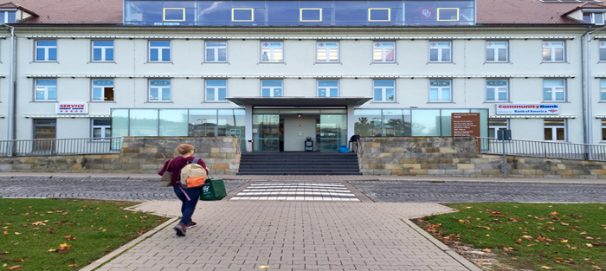
Army Community Service
Panzer Kaserne,
Community Services Building 2915, 2nd floor
Directly across the parking lot from the eXchange!
DSN 596-3362 CIV 09641-70-596-3362
https://stuttgart.armymwr.com/
Notes:
Currently, most ACS services are provided virtually by phone, email and Facebook. Lending closet is available on select days to accommodate those in and out processing. To access services such as the lending closet and translation services, please give us a call!

